Slide 1
CSE 420
Intermediate Code Generation
Compilers principles, techniques, & tools-ULLMAN
Chapter 06

Slide 2
Compiler Architecture
Intermediate Code
Parser
Static Checker
Intermediate Code generator
Code Generator
Target language
Front End
Back End
m × n compliers can be built by writing m front ends and n back ends – save considerable amount of effort
We assume parsing, static checking and IC generation is done sequentially
  These can be combined and done during parsing
Static checking
  Operator operand compatibility
  Proper placement of break/continue keywords etc.

Slide 3
Intermediate Code (IC)
The given program in a source language is converted to an equivalent program in an intermediate language by the IC generator.
Ties the front and back ends together
Language and Machine neutral
Many forms
Level depends on how being processed
More than one intermediate language may be used by a compiler

Slide 4
Intermediate Representations
In most compilers, the parser builds an intermediate representation of the program
Rest of the compiler transforms the IR to “improve” (optimize) it and eventually translates it to final code
  Often will transform initial IR to one or more different IRs along the way
G-<number>

Slide 5
IR Design
Decisions affect speed and efficiency of the rest of the compiler
Desirable properties
  Easy to generate
  Easy to manipulate
  Expressive
  Appropriate level of abstraction
Different tradeoffs depending on compiler goals
Different tradeoffs in different parts of the same compiler
G-<number>
Notes:
Au02: taken from Cooper’s slides

Slide 6
Types of IRs
Three major categories
  Structural
  Linear
  Hybrid
Some basic examples now; more when we get to later phases of the compiler
G-<number>
Notes:
Au02: based on Cooper’s slides

Slide 7
Levels of Abstraction
Key design decision: how much detail to expose
  Affects possibility and profitability of various optimizations
  Structural IRs are typically fairly high-level
  Linear IRs are typically low-level
  But these generalizations don’t always hold
G-<number>

Slide 8
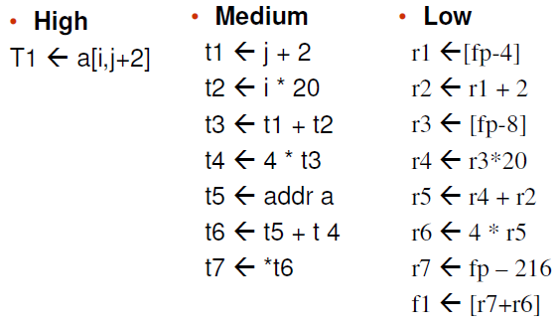
Intermediate language levels

Slide 9
Intermediate Languages Types
Graphical IRs:
  Syntax trees
  Abstract Syntax trees
  Directed Acyclic Graphs (DAGs)
  Control Flow Graphs
Linear IRs:
  Stack based (postfix)
  Three address code (quadruples)

Slide 10
Graphical IRs
Concrete Syntax Trees
Abstract Syntax Trees (AST) – retain essential structure of the parse tree, eliminating unneeded nodes.
Directed Acyclic Graphs (DAG) – compacted AST to avoid duplication – smaller footprint as well
Control flow graphs (CFG) – explicitly model control flow

Slide 11
Structural IRs
Typically reflect source (or other higher-level) language structure
Tend to be large
Examples: syntax trees, DAGs
Particularly useful for source-to-source transformations
The full grammar is needed to guide the parser, but contains many extraneous details
Typically the full syntax tree does not need to be used explicitly
G-<number>
Notes:
Au02: based on Cooper’s slides

Slide 12
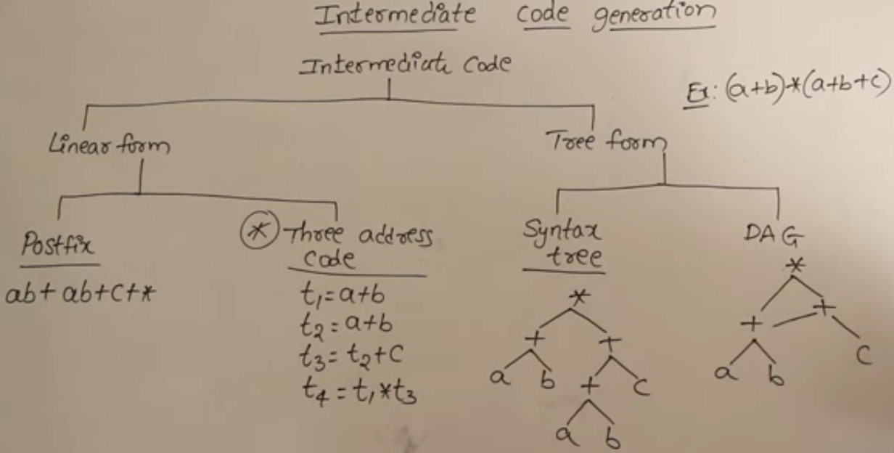

https://www.youtube.com/watch?v=y_Bowd4NvFg

Slide 13
a := b *-c + b*-c
ASTs and DAGs:
:=
:=
a
+
a
+
*
b - (uni)
*
*
- (uni)
b - (uni)
b
c
c
c
AST
DAG

Slide 14
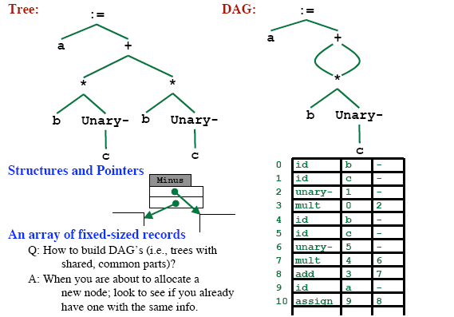
Implementation of DAG/AST: Value Number Method

Slide 15
Three-Address code
Many different representations
General form: x ← y (op) z
  One operator
  Maximum of three names
Example: x=2*(n+m); becomes
  t1 ← n + m
  t2 ← 2 * t1
  x ← t2
G-<number>

Slide 16
Three Address Code (cont)
Advantages
  Resembles code for actual machines
  Explicitly names intermediate results
  Compact
  Often easy to rearrange
Various representations
  Quadruples, triples, SSA
  Much more later…
G-<number>

Slide 17
Three-Address Code
A three-address code is:
x := y op z
where x, y and z are names, constants or compiler-generated temporaries; op is any operator.
But we may also the following notation for three-address code (it looks like a machine code instruction)
op y,z,x
apply operator op to y and z, and store the result in x.
We use the term “three-address code” because each statement usually contains three addresses (two for operands, one for the result).

Slide 18
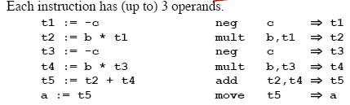
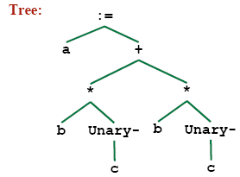
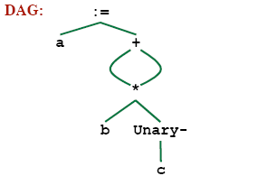
Linearized Representation of DAG/AST
Source Code
– a = b * -c + b * -c
Three address code
Tree Representation

Slide 19
Three-Address Statements
Binary Operator: op y,z,result or
result := y op z
where op is a binary arithmetic or logical operator. This binary operator is applied to y and z, and the result of the operation is stored in result.
Ex:
add a,b,c
gt a,b,c addr a,b,c
addi a,b,c
Unary Operator: op y,,result or
result := op y
where op is a unary arithmetic or logical operator. This unary operator is applied to y, and the result of the operation is stored in result.
Ex: uminus a,,c

Slide 20
Three-Address Code
Two concepts
  Address
  Instruction
Address
  Name: source-program names to appear as addresses
  Constant: Different types of constants
  Compiler Generated temporary:

Slide 21
Three-Address Instruction
Assignment Type 1: x := y op z
op is a binary arithmetic or logical operation
x, y and z are addresses
Assignment Type 2: x := op z
op is a unary arithmetic or logical operation
x and z are addresses
Copy Instruction: x := y
x and z are addresses and x is assigned the value of y

Slide 22
Three-Address Instructions
Unconditional Jump: goto L
We will jump to the three-address code with the label L, and the execution continues from that statement.
Ex: goto L1 jmp 7
Conditional Jump 1: if
// jump to L1
// jump to the statement 7
x goto L and if False
x goto L
We will jump to the three-address code with the label L if x is TRUE
and FALSE, respectively. Otherwise, the following three-address instruction in sequence is executed next.
Conditional Jump 2: if x relop y goto L
We will jump to the three-address code with the label L if the result of y relop z is true, and the execution continues from that statement. If the result is false, the execution continues from the statement following this conditional jump statement.

Slide 23
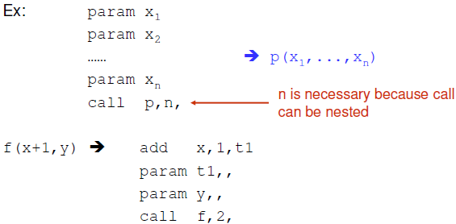
Three-Address Statements (cont.)
Procedure Parameters: param x
Procedure Calls: call p,n
where x is an actual parameter, we invoke the procedure p with
n parameters.

Slide 24
Three-Address Statements (cont.)
Indexed Assignments:
x := y[i]
sets x to the value in location i memory units beyond location y
y[i] := x
sets contents of the location i memory units beyond location y to the value of x
Address and Pointer Assignments:
x := &y
sets the r-value of x to l-value of y
x := *y
where y is a pointer whose r-value is a location
sets the r-value of x equal to the contents of that location
*x := y
sets the r-value of the object pointed by x to the r-value of y

Slide 25
Forms of three address instructions
x = y op z
x = op y
x = y
goto L
if x goto L and ifFalse x goto L
if x relop y goto L
Procedure calls using:
  param x
  call p,n
  y = call p,n
x = y[i] and x[i] = y
x = &y and x = *y and *x =y

Slide 26
Three address code example
do i=i+1; while (a[i] < v)
L: t₁=i+1 | 100: | t₁ = i +1
i=t₁ | 101: | i = t₁
t₂=i*8 | 102: | t₂=i*8
t₃=a[t₂] | 103: | t₃=a[t2]
if t₃ < v goto L | 104: | if t₃ < v goto 100
(A) Symbolic Labels | (B) Position Numbers

Slide 27

Representing 3-Address Statements
op, arg1, arg2, result
x = minus y
  Does not use arg2
x = y
  Op is =
param a1
  Uses neither arg2 nor result
Conditional/Unconditional jumps
– Put the target label in result

Slide 28
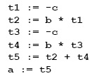
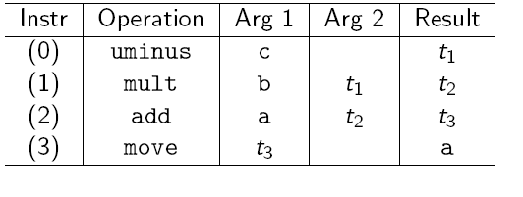
Quadruples
• a = b * -c + b * -c

Slide 29
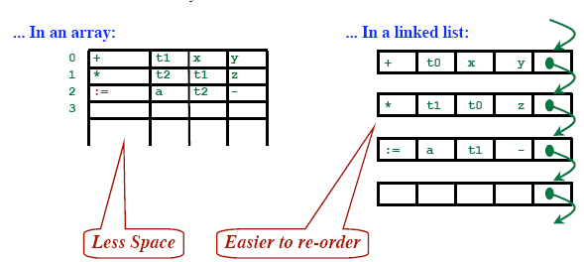
Quadruples
Store each fields directly

Slide 30
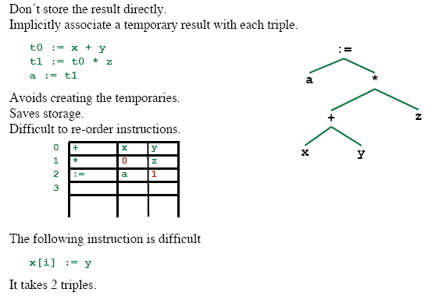
Triples
op | arg1 | arg2
[ ]= | x | i
:= | 0 | y
0
1

Slide 31
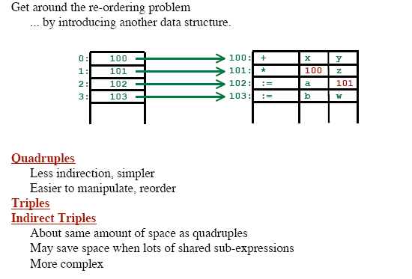
Indirect Triples

Slide 32
Example
Three address code
t1 = minus c
t2 = b * t1
t3 = minus c
t4 = b * t3
t5 = t2 + t4
a = t5
b * minus c + b * minus c
Quadruples
Triples
Indirect Triples
op
arg1
arg2
result
op
arg1
arg2
op
op
arg1
arg2
minus
c
t1
0
minus
c
35
(0)
0
minus
c
*
b
t1
t2
1
*
b
(0)
36
(1)
1
*
b
(0)
minus
c
t3
2
minus
c
37
(2)
2
minus
c
*
b
t3
t4
3
*
b
(2)
38
(3)
3
*
b
(2)
+
t2
t4
t5
4
+
(1)
(3)
39
(4)
4
+
(1)
(3)
=
t5
a
5
=
a
(4)
40
(5)
5
=
a
(4)

Slide 33
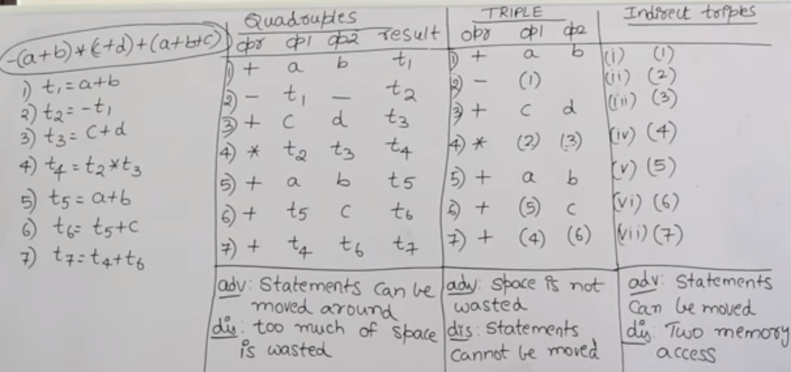
https://www.youtube.com/watch?v=FLtbrZBhHKA

Slide 34
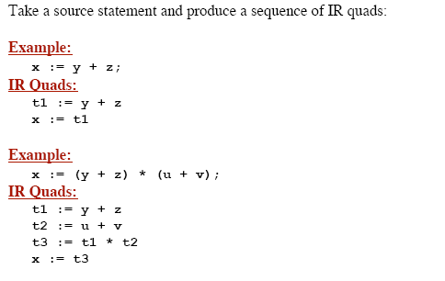
Goal

Slide 35
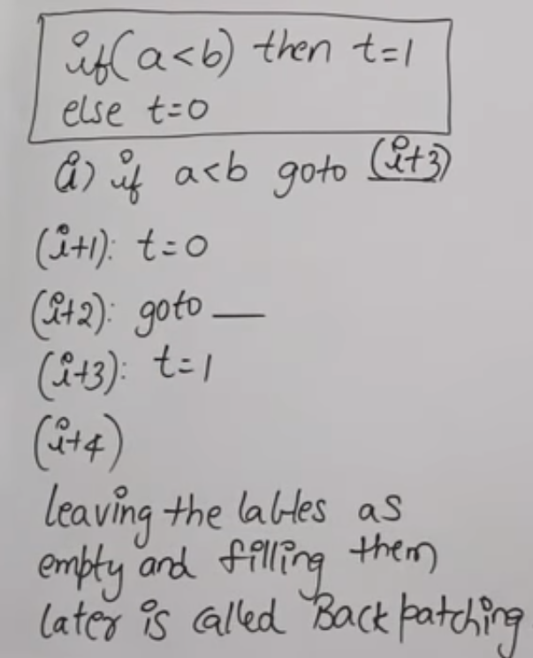
Back patching and conversations to 3 address code
https://www.youtube.com/watch?v=kkJwIHkRmoE&t=182s

Slide 36
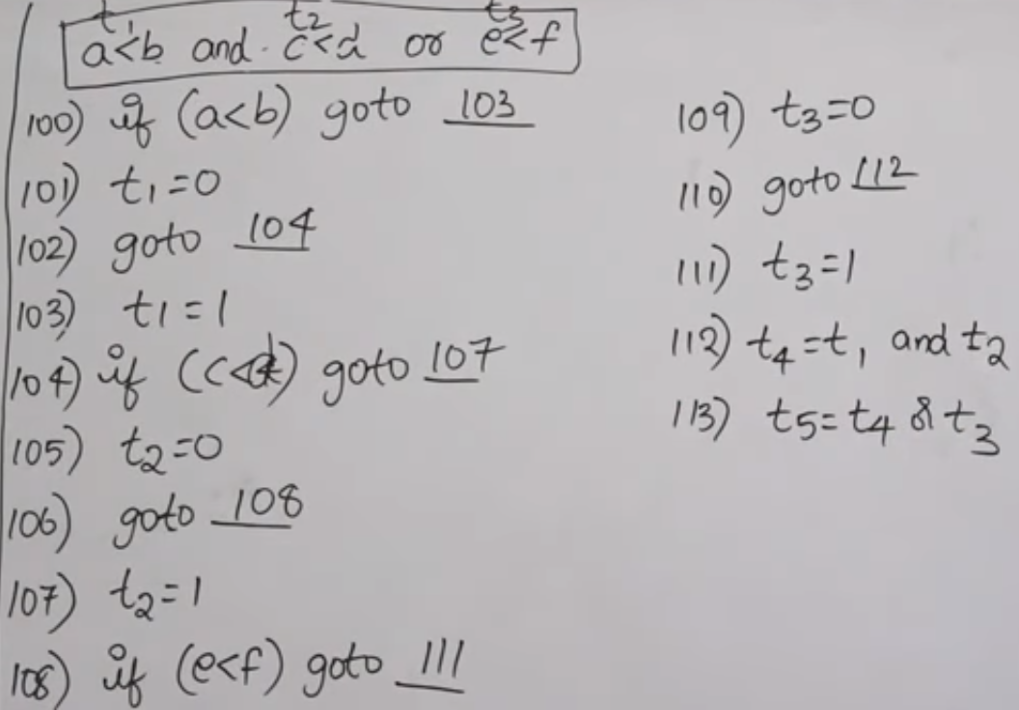
Back patching and conversations to 3 address code

Slide 37
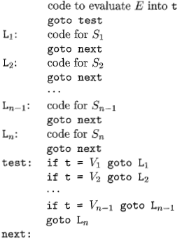
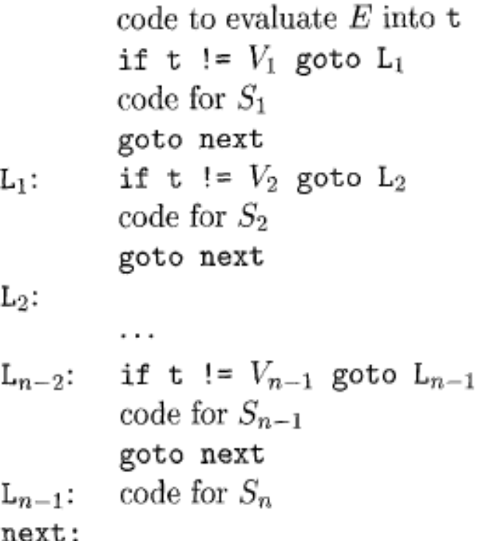
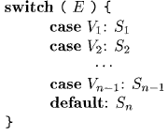
Translation of a switch-statement

Slide 38
Addressing Array Elements
Elements of arrays can be accessed quickly if the elements are stored in a block of consecutive locations.
A one-dimensional array A:
 | … |  | …
base_{A} low
i
width
base_{A} is the address of the first location of the array A,
width is the width of each array element. low is the index of the first array element

Slide 39
Addressing Array Elements (cont.)
base_{A}+(i-low)*width
can be re-written as i*width
+ (base_{A}-low*width)
should be computed at run-time
can be computed at compile-time
So, the location of A[i] can be computed at the run-time by evaluating the formula i*width+c where c is (base_{A}-low*width) which is evaluated at compile-time.
Intermediate code generator should produce the code to evaluate this formula i*width+c (one multiplication and one addition operation).

Slide 40
Two-Dimensional Arrays
A two-dimensional array can be stored in
  either row-major (row-by-row) or
  column-major (column-by-column).
Most of the programming languages use row-major method.
Row-major representation of a two-dimensional array:
row₁
row₂
row_{n}

Slide 41
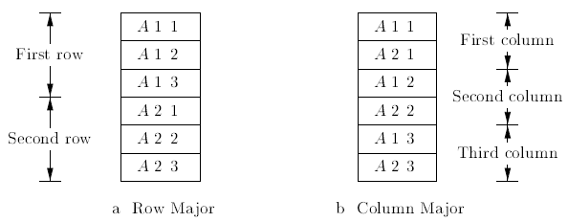
Layout of Two-Dimensional Arrays

Slide 42
Two-Dimensional Arrays (cont.)
The location of A[i₁,i₂] is
base_{A}+ ((i₁-low₁)*n₂+i₂-low₂)*width
base_{A} is the location of the array A.
low₁ low₂
is the index of the first row
is the index of the first column
n₂ is the number of elements in each row
width is the width of each array element
Again, this formula can be re-written as ((i₁*n₂)+i₂)*width + (base_{A}-((low₁*n₁)+low₂)*width)
should be computed at run-time
can be computed at compile-time

Slide 43
Translation of Array Elements
One dimensional
base + i × w
w: width of each array element
Two Dimensional
base + i₁ × w₁ + i₂ × w₂
w₁: width of a row
w₂: width of an element in a row

Slide 44
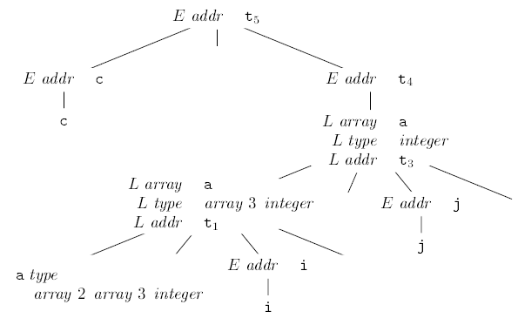
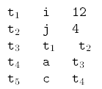
Let a denote a 2x3 array of integers, and let c, i, j all integers. Then, type of a is array(2, array(3, integer)). w₁= 12, w₂ = 4.

Slide 45
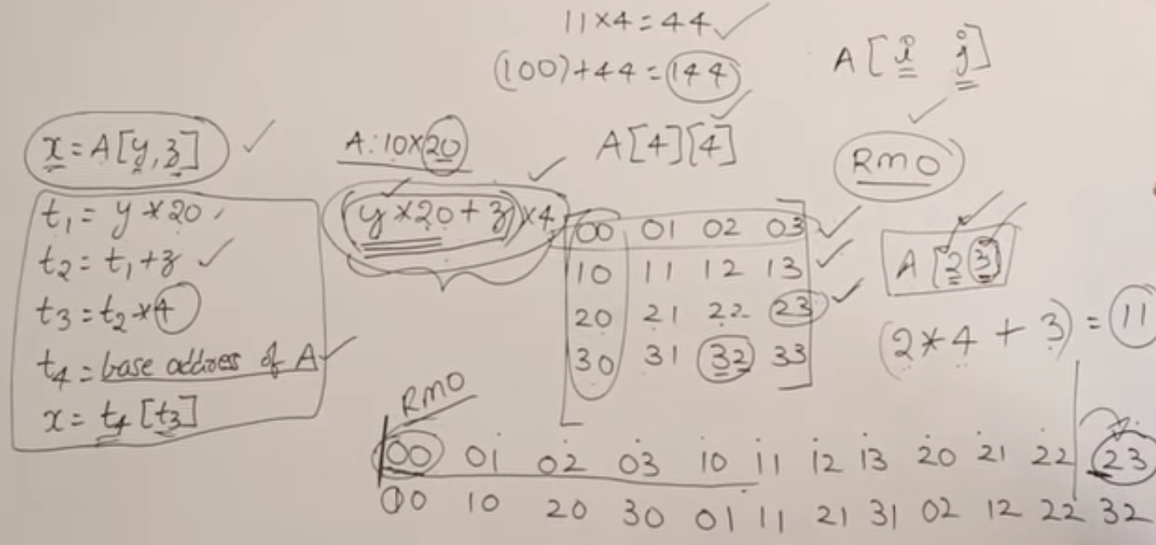
https://www.youtube.com/watch?v=XFROmSJQzfA

Slide 46
Any Question?

